Slide 1
DSP & MACHINE LEARNING
Audio Signal Analysis
Bridging the gap from the DTFT to practical STFTs and Power Spectra.

Slide 2
The Ideal vs. The Practical
Discrete-Time Fourier Transform (DTFT)
Infinite duration: Requires signal knowledge from beginning to end.
X(ejω) = ∑ x[n] e^{-jωn}
Continuous frequency: Results in an uncomputable continuous spectrum.
BEAUTIFUL MATH. UNCOMPUTABLE REALITY.
Hardware limitation: Computers have finite memory arrays.

Slide 3
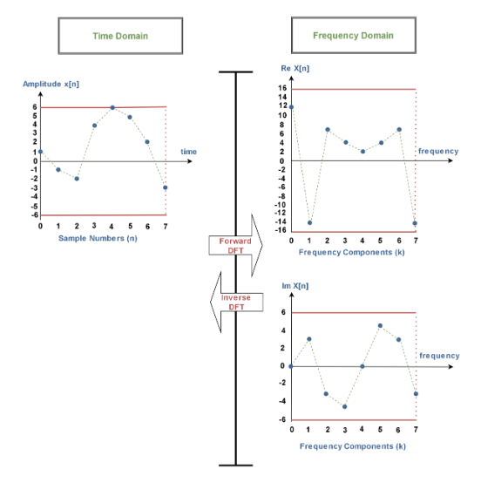
Bridging to the DFT
Sampling the Spectrum
We solve the continuous frequency problem by sampling the DTFT at N equally spaced points between 0 and 2π.
X[k] = ∑ x[n] e^{-j(2π/N)kn}

Slide 4

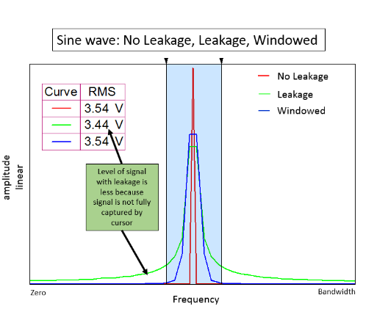
The Cost of Truncation
Spectral Leakage
Finite Observation Extracting N samples equals multiplying by a rectangular window.
Time-Frequency Duality Multiplication in time is convolution in frequency.
The Sinc Smear Energy bleeds into adjacent frequency bins.

Slide 5
STOCHASTIC SIGNALS
Power Spectral Density (PSD)
1
Audio signals have infinite energy over time.
2
We analyze finite power distribution across frequencies instead.
Sxx(ω) = ∑ rxx[m] e^{-jωm}
Wiener-Khinchin Theorem: PSD is the Fourier transform of the autocorrelation sequence.

Slide 6


Estimating PSD: The Periodogram
DIRECT COMPUTATION
P[k] = (1/N) |X[k]|²
Efficient
High Variance
Computed via Fast Fourier Transform.
Noisy estimate without averaging (Welch's).

Slide 7
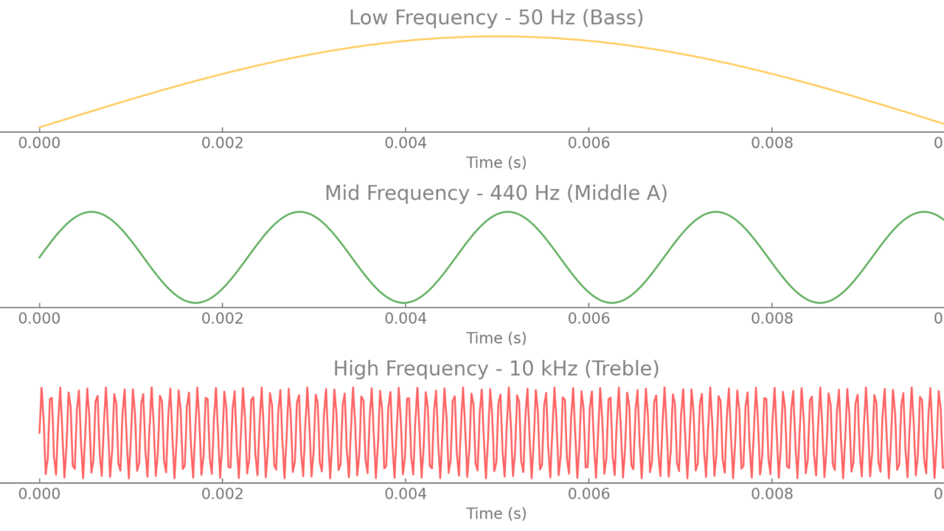
THE REALITY OF AUDIO
Signals are Non-Stationary
A global DFT reveals exactly what frequencies exist, but completely destroys when they occurred.

Slide 8
The Short-Time Fourier Transform
Mapping the time-frequency landscape.

Slide 9



The STFT Pipeline
1. Frame
2. Window
3. Transform
Extract localized segment.
Taper edges to zero.
Compute local spectrum.

Slide 10

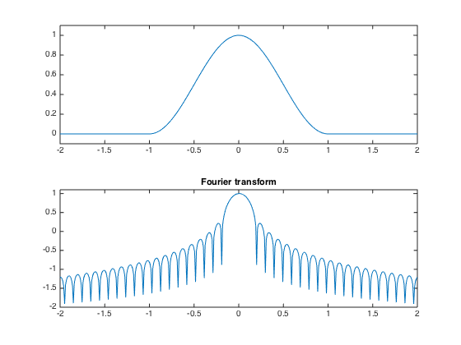
Maintaining Continuity
The Issue
The Solution
Windowing heavily suppresses data at frame edges. Contiguous frames drop energy.
Overlap frames (typically 50-75%). A smaller Hop Size increases temporal density.

Slide 11
THE UNCERTAINTY PRINCIPLE
Time vs. Frequency Resolution
Long Window (N ↑)
Short Window (N ↓)
Time Resolution: Poor localization.
Time Resolution: Sharp localization.
Frequency Resolution: High precision.
Frequency Resolution: Smeared bands.
Best for: Stable harmonic chords.
Best for: Percussion and transients.

Slide 12

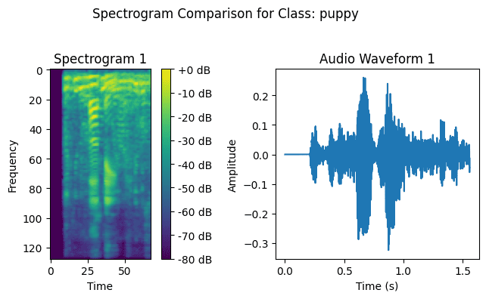
Visualizing the STFT: Spectrogram
STFT Matrix Magnitude: |X(t, f)|
Y: Frequency
X: Time
Color: Power

Slide 13

Interactive Session
Open Jupyter Notebook:
audio_stft_demo.ipynb
Task 1
Task 2
Task 3
Vary window size.
Observe hop size impact.
Listen to synthesis.

Slide 14
Questions?
Next Class: Overlap-Add Synthesis & Filterbanks

Slide 15





Image Sources
https://www.electronics-lab.com/wp-content/uploads/2023/09/FIGURE-3_DFT.png
Source: www.electronics-lab.com
https://community.sw.siemens.com/servlet/rtaImage?eid=ka6KZ00000000iN&feoid=00N4O000006Yxpf&refid=0EM4O000001130x
Source: community.sw.siemens.com
https://www.masteringbox.com/wp-content/uploads/2025/03/Frequency-tab-2048x1016.png
Source: www.masteringbox.com
https://www.numerical-tours.com/matlab/audio_1_processing/index_06.png
Source: www.numerical-tours.com
https://media.geeksforgeeks.org/wp-content/uploads/20231011105320/ad3-(1).png
Source: www.geeksforgeeks.org

